Slide 1


運用Google-Cloud-Vision-Based
半自動照片分類檢索技術之POI
製作系統
指導教授 : 黃崇明
專題成員 : 呂兆凱、魏湧致、江羿賢、陳維竑

Slide 2

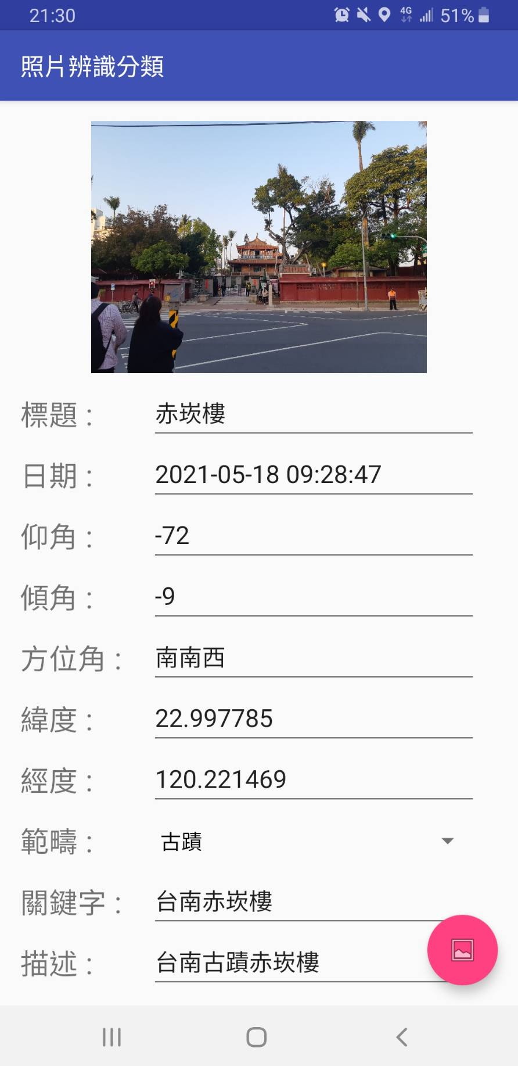
OUTLINE
Introduction
Architecture
Main Technical Issues
System Development and Implementation
Usages and Examples
Conclusion

Slide 3

Introduction

Slide 4




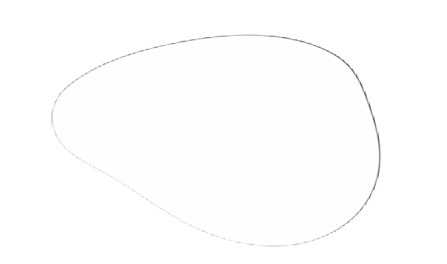


Slide 5
Motive
With the improvement of the quality of mobile phone cameras, we can use it to take photos anytime and anywhere to preserve memories, and even upload them to social platforms to share with our friends.
With the accumulation of photos, it is difficult to quickly find specific photos.
Manually adding tags to photos may be a solution; however, it’s a tedious and time consuming procedure. If we could build a convenient system to add tags on photos automatically and search it by these tags, it would be very useful. Furthermore, base on the system, we could build a system to let everyone build their own series of album and share with others.

Slide 6
Our goal
Convenience:
Build a convenient system to make everyone use it easily. Not need too much device, all you need is one smartphone to get these services.
Save Times & Build Portfolio:
Apply the AI analysis to help the user save their time on adding tags to photos. Moreover, building a platform to make users create a POI(Point Of Interesting) and let the fascinating picture can be shared with others.
Discover the wonderful world:
As the saying goes, beauty is everywhere. For our eyes, not the lack of beauty, but the lack of discovery. In addition to making users enjoy these captivating photos, the system can let you know more interesting place.

Slide 7

Architecture

Slide 8




Architecture
Web Browser：
Server：
APP：
Google Cloud Vision：
Create POIs
View existing POI data
Saving Data
Restful API for app and website
Photo Labeling System
-Manual
-Phone Information
-AI
Sending Analysis Results to Phone

Slide 9
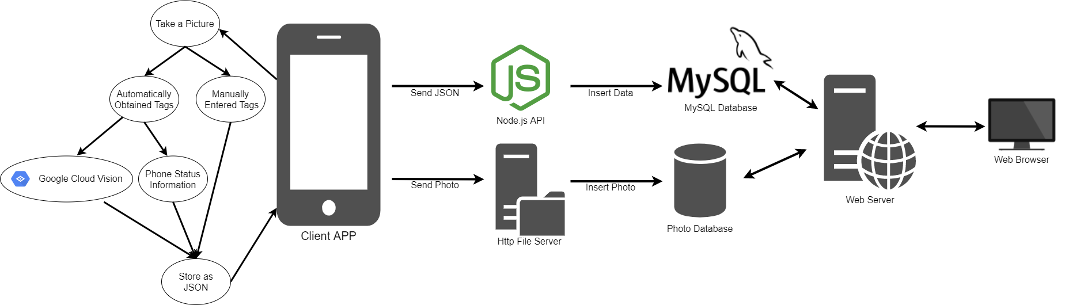
Data Transfer

Slide 10
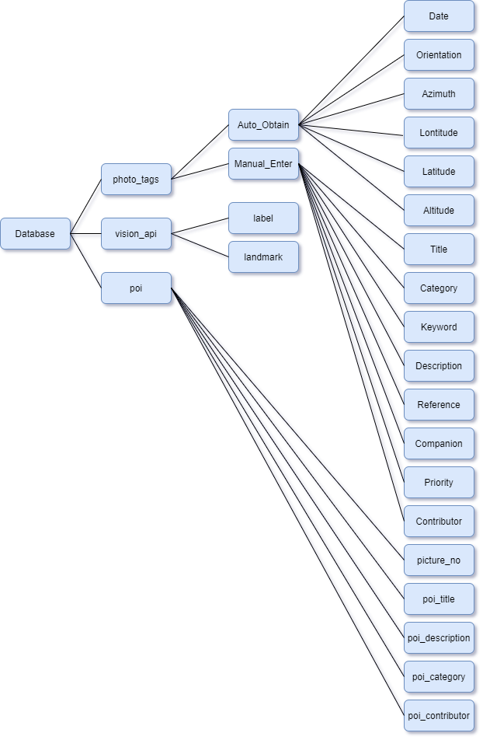
Database Architecture
photo_tags:
To store basic attributes of photos, divided into Auto_Obtain & Manual_Enter.
Auto_Obtain stores the status from this phone, Ex : Time, Latitude.
Manual_Enter stores the tags entered by user, Ex : Keyword, Description.
vision_api:
To store the Google Cloud Vision auto-generating photo features selected by the user.
poi:
To store the poi data which was produced by user.

Slide 11

Main
Technical
Issues

Slide 12
Main Technical Issues
A. How to classify each photo and recognize it efficiently
B. Base on above technique, how to search photos
C. What are the components of POI system

Slide 13
A. How to classify each photo and recognize it efficiently
1. Manually tagging? AI analysis?
- Both
2. If we use AI, how to cope with precision problem?
- sorting by confidence rating for users to choose
3. What items should we store for each photo to make it
user-friendly?
- photo tags & Cloud Vision

Slide 14
A. How to classify each photo and recognize it efficiently
4. How to transfer data from the mobile APP to the database?
- HFS server for photo & Node.js API for photo tags
5. Android & iOS have many versions, which version should we
choose?
- Android 4.0 and iOS 13 or above could cover 98% users

Slide 15
B. Base on above technique, how to search photos
1. Search by image? Search by keywords?
- keyword
2. What scope should we provide to users for searching photos?
- title, date, keyword, description, reference, contributor,
category, priority, label, landmark
3. If users search photos by keywords, it may hard to exactly
match data in database.
- use fuzzy search

Slide 16
B. Base on above technique, how to search photos
4. It will have conflicts when there are multiple users use
searching system.
- login subsystem
5. The labels generated by google cloud vision is up to tens of
thousands, it’s hard for users to remember what labels they
have chosen.
- compare prefix, recommend similar labels

Slide 17
C. What are the components of POI system
1. What content contained in POIs?
- title, description, category, contributor
2. How to make user view existing POIs suitably?
- POI list as home page

Slide 18

System
Development
and
Implementation

Slide 19
Website
APP
Search Photo
Create POIs (Authoring)
View Existing POIs List & Content
Take Photo or choose photo from phone
Use Some Techniques To Label Photo
Upload Photo & Labels

Slide 20
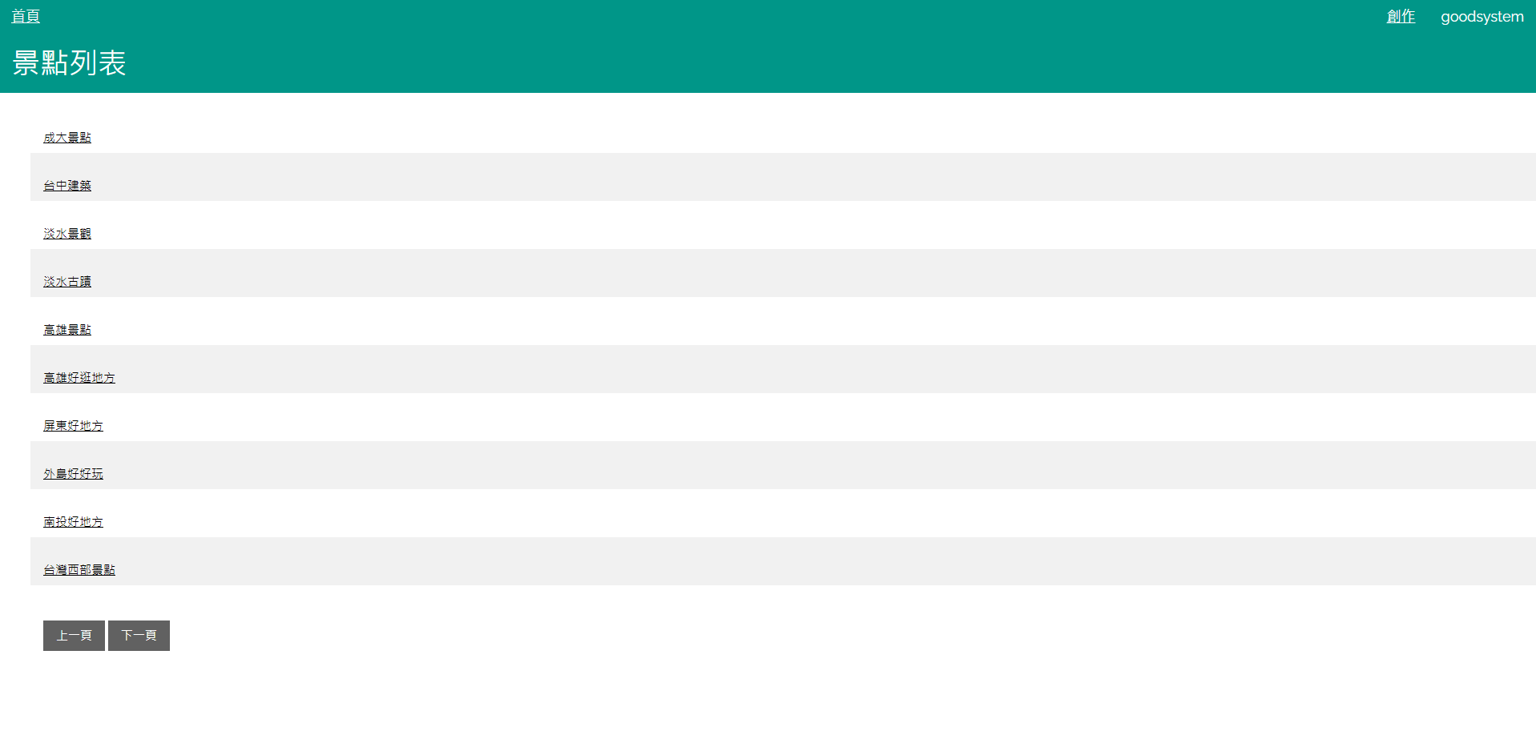
Website - POI List

Slide 21
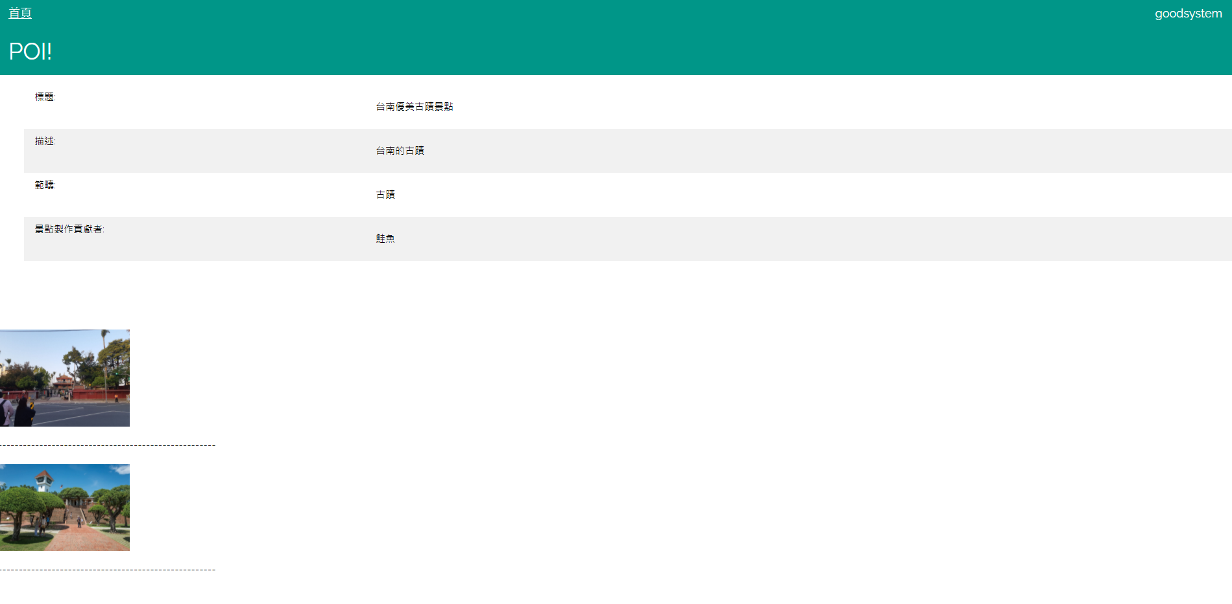
Website - POI Content

Slide 22
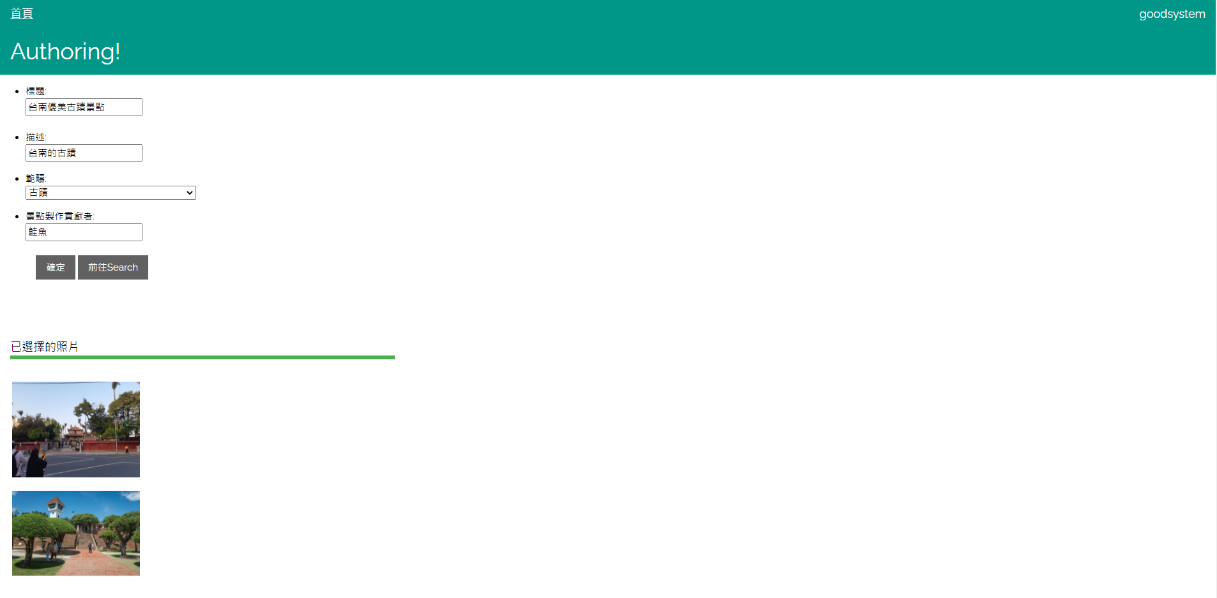
Website - POI Authoring

Slide 23
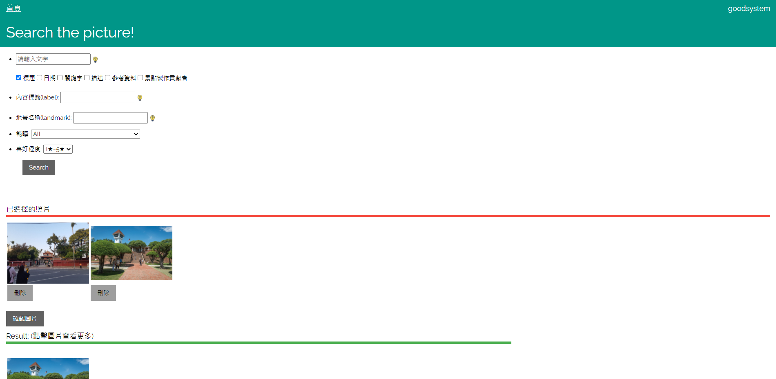
Website - Search

Slide 24
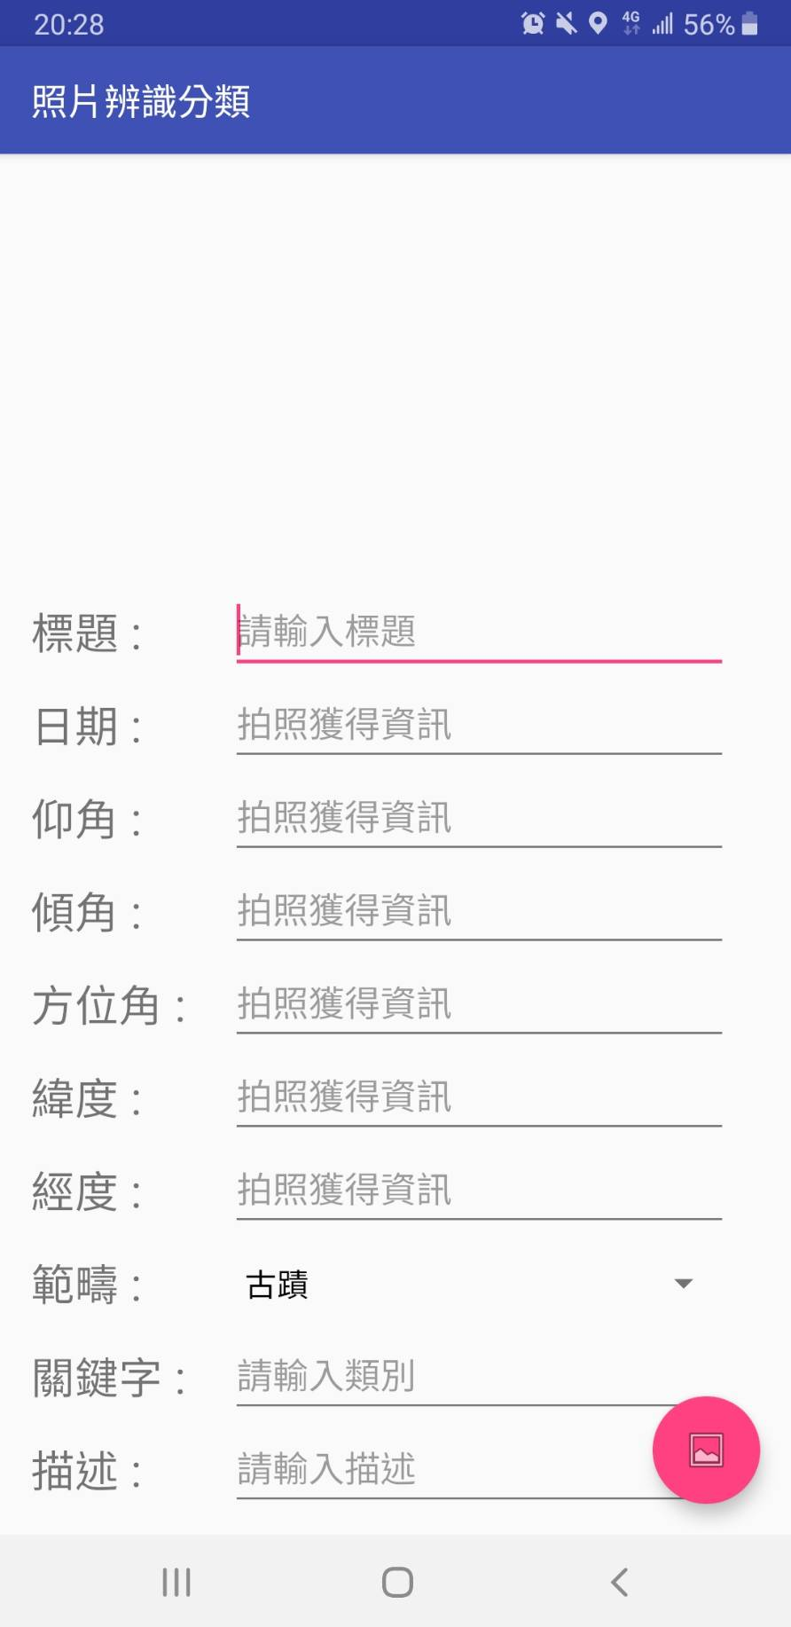
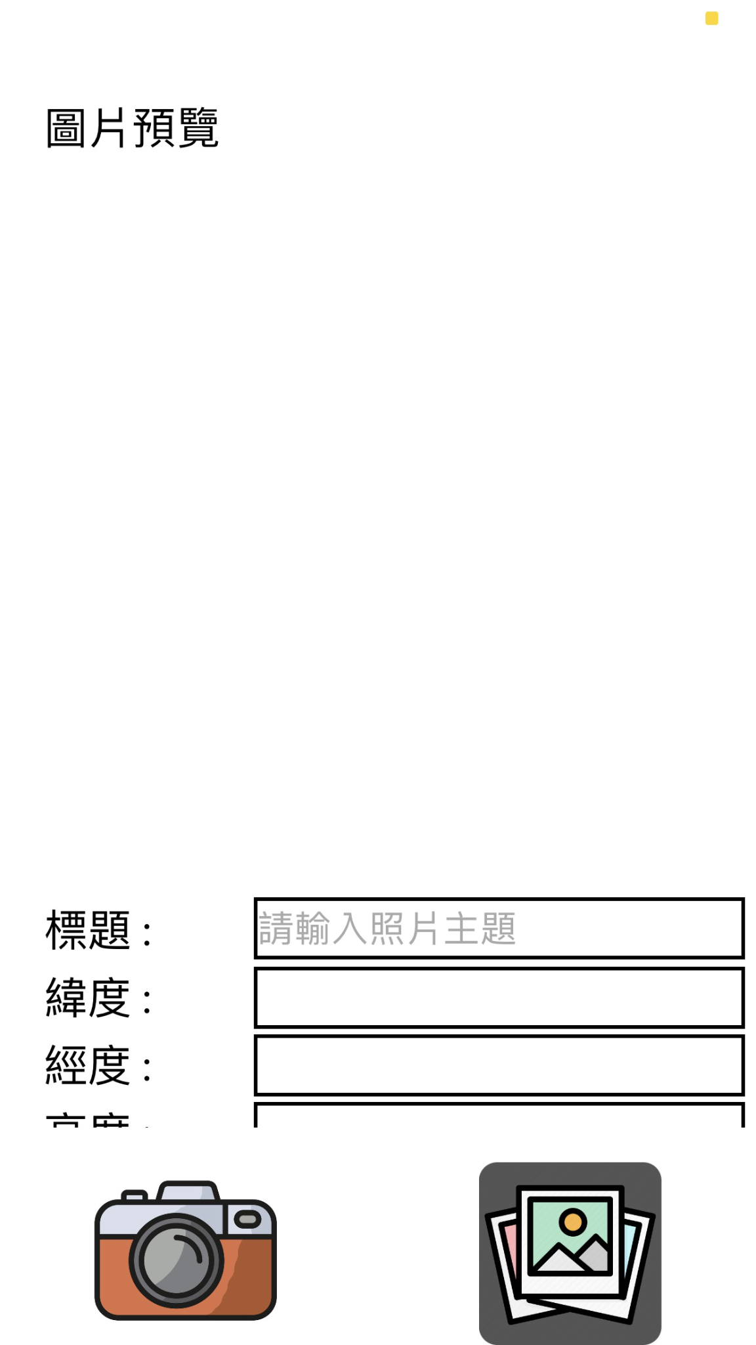
APP - Start
Android
iOS

Slide 25
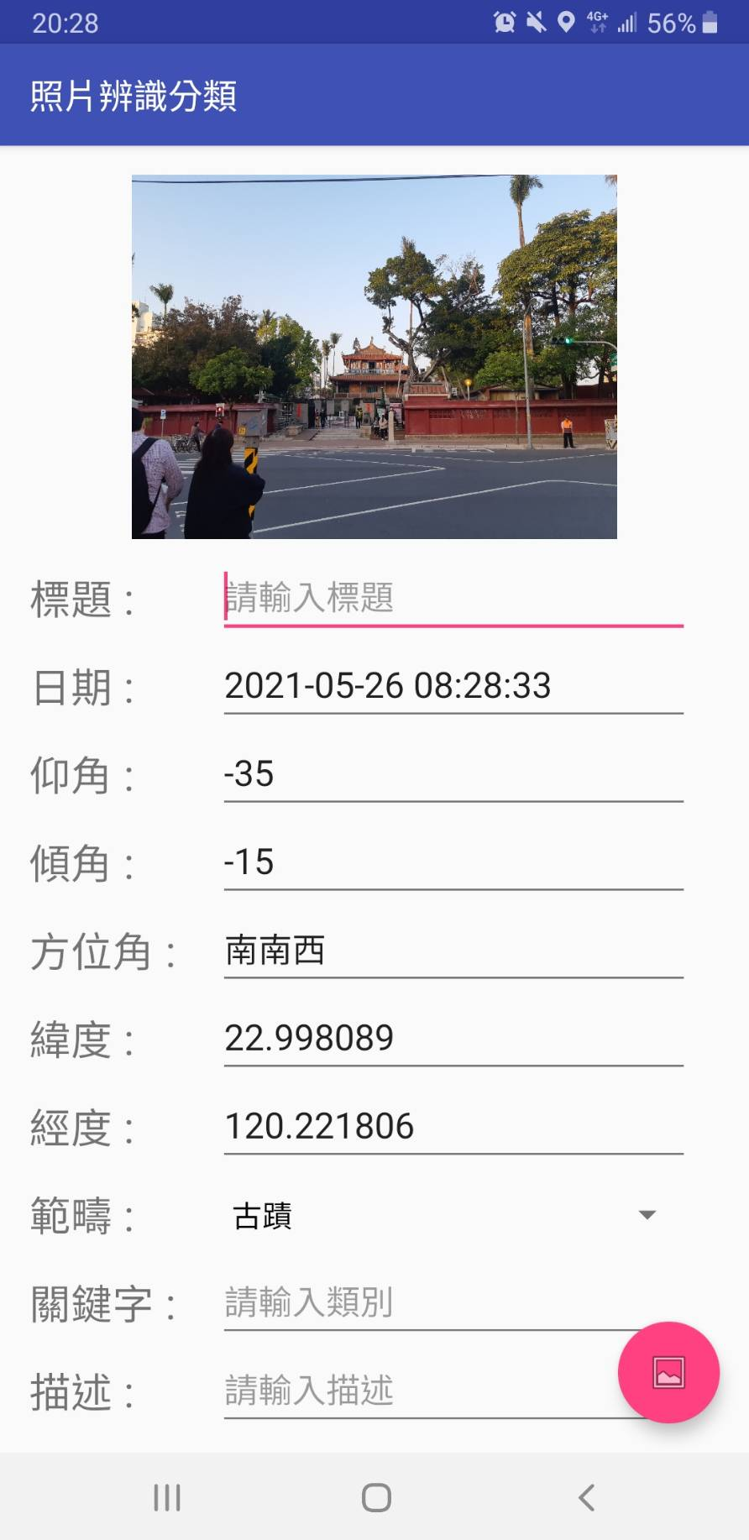
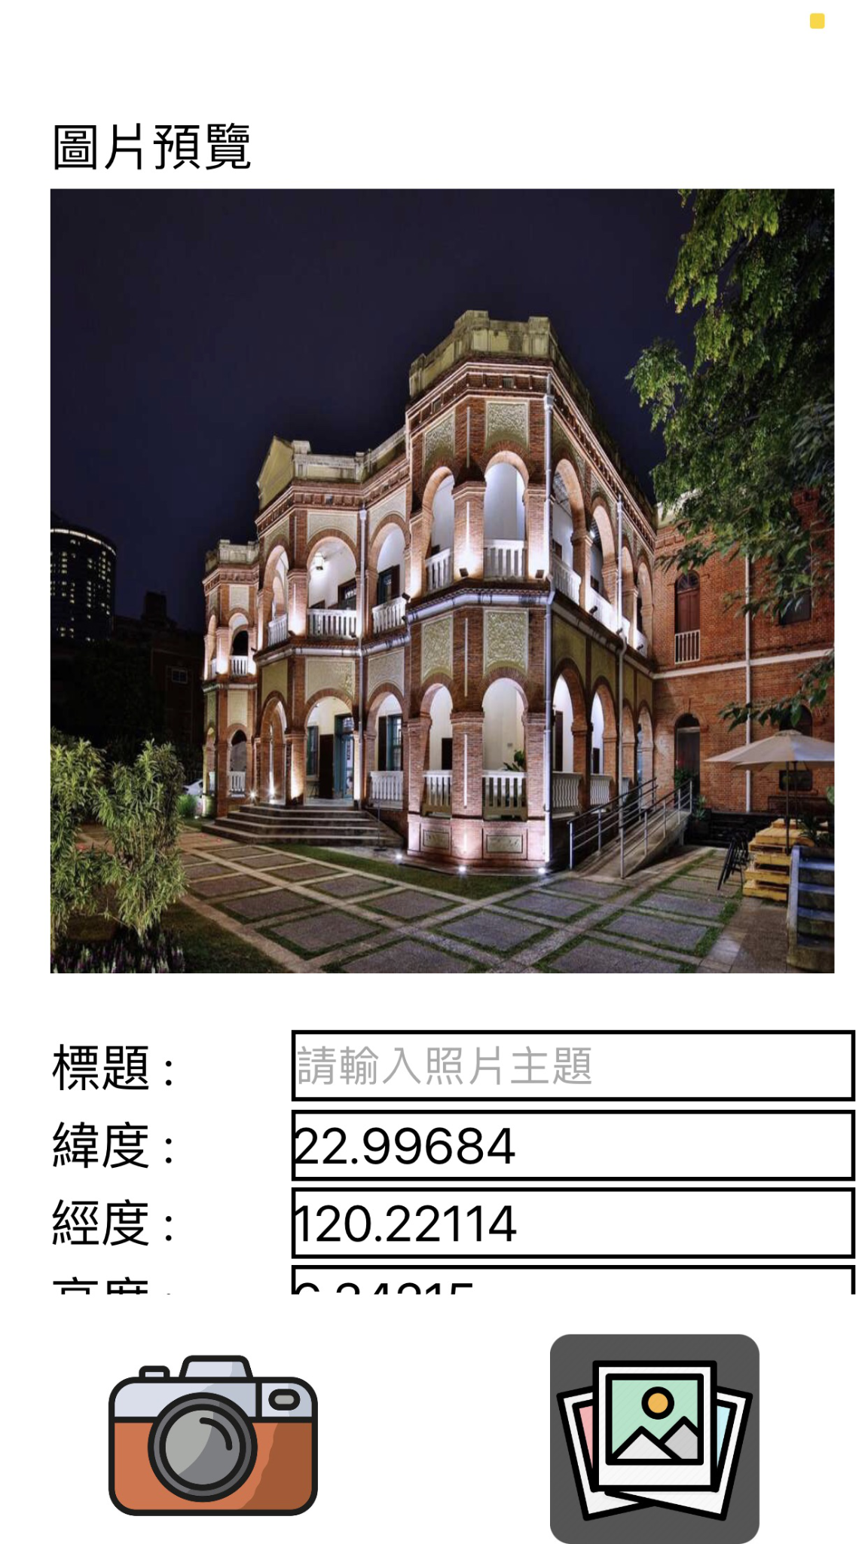
APP - Automated Adding Tags
Android
iOS

Slide 26
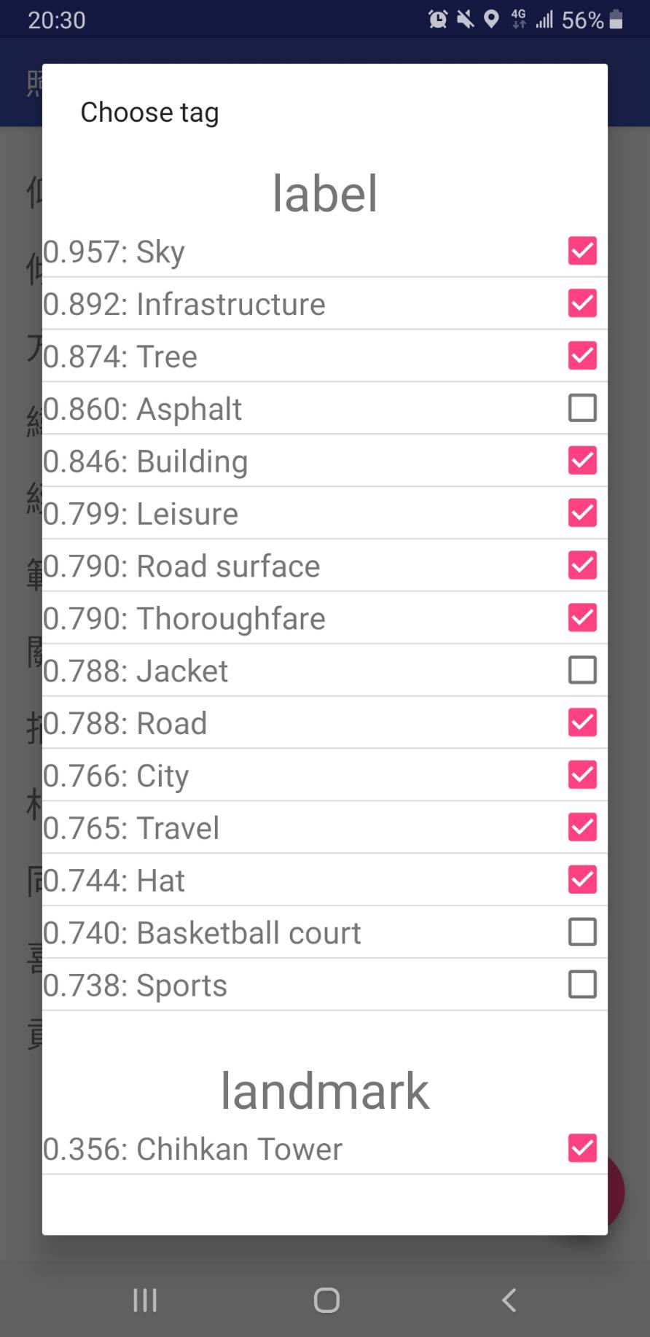
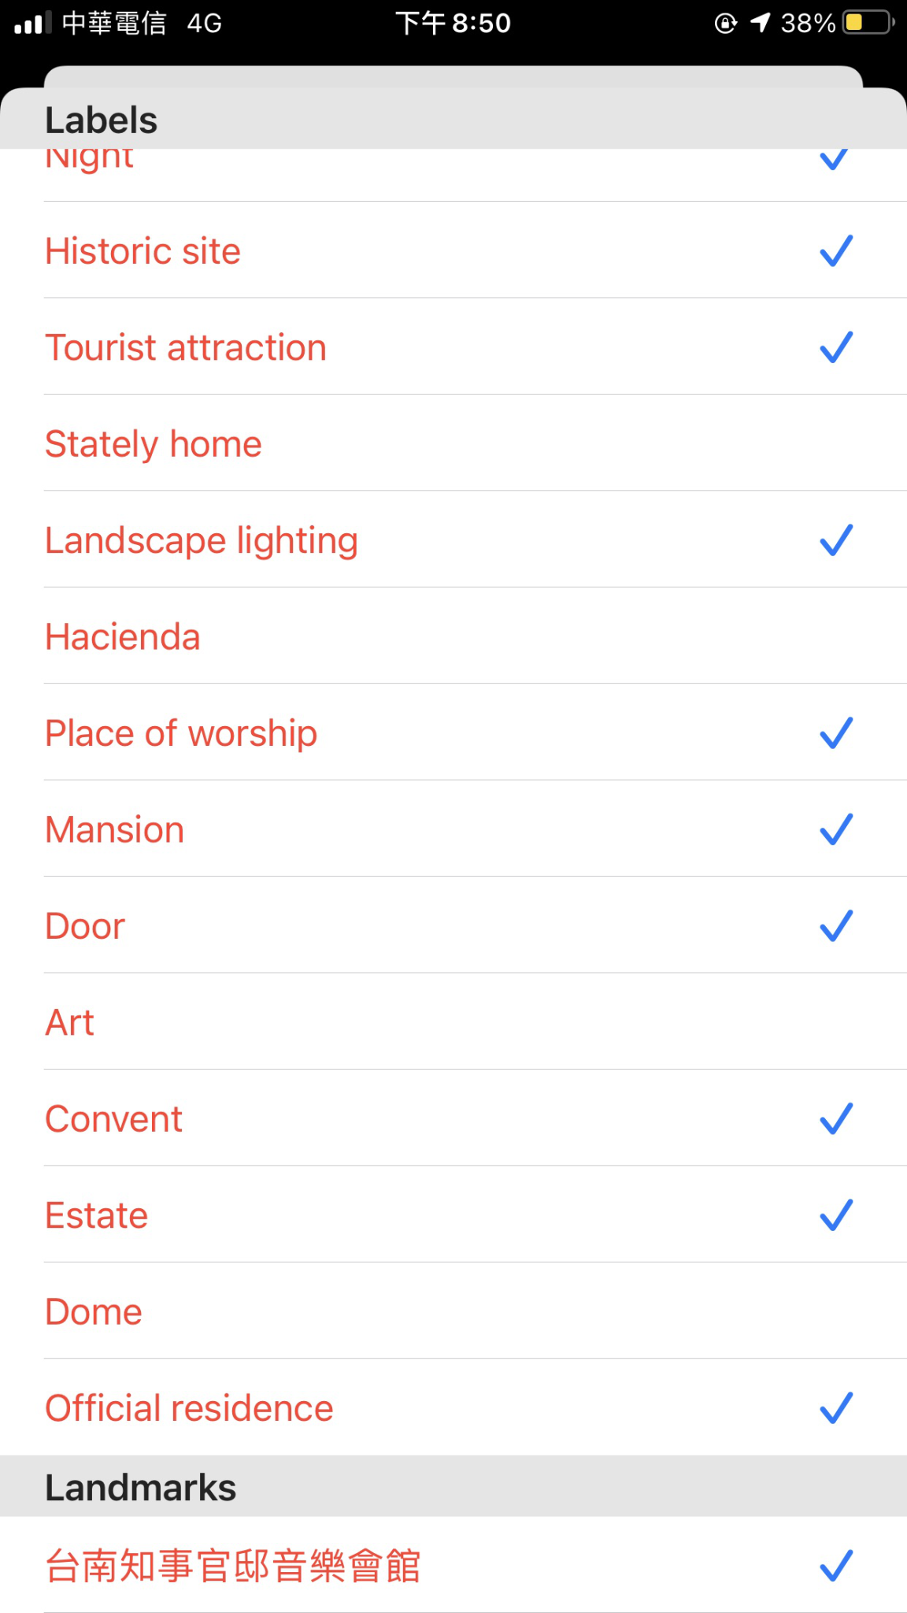
APP - Google Cloud Vision
Android
iOS

Slide 27
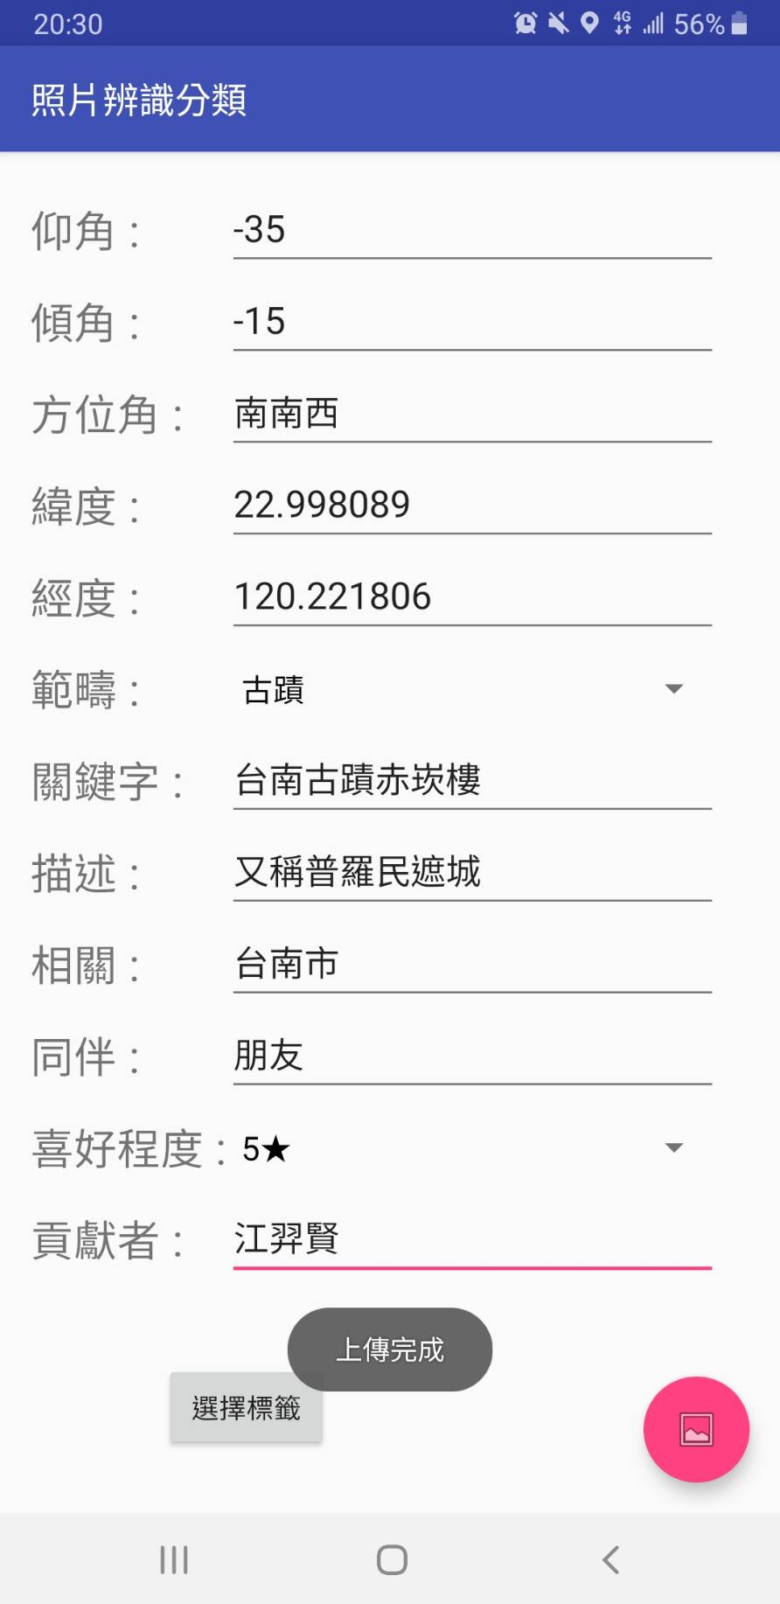
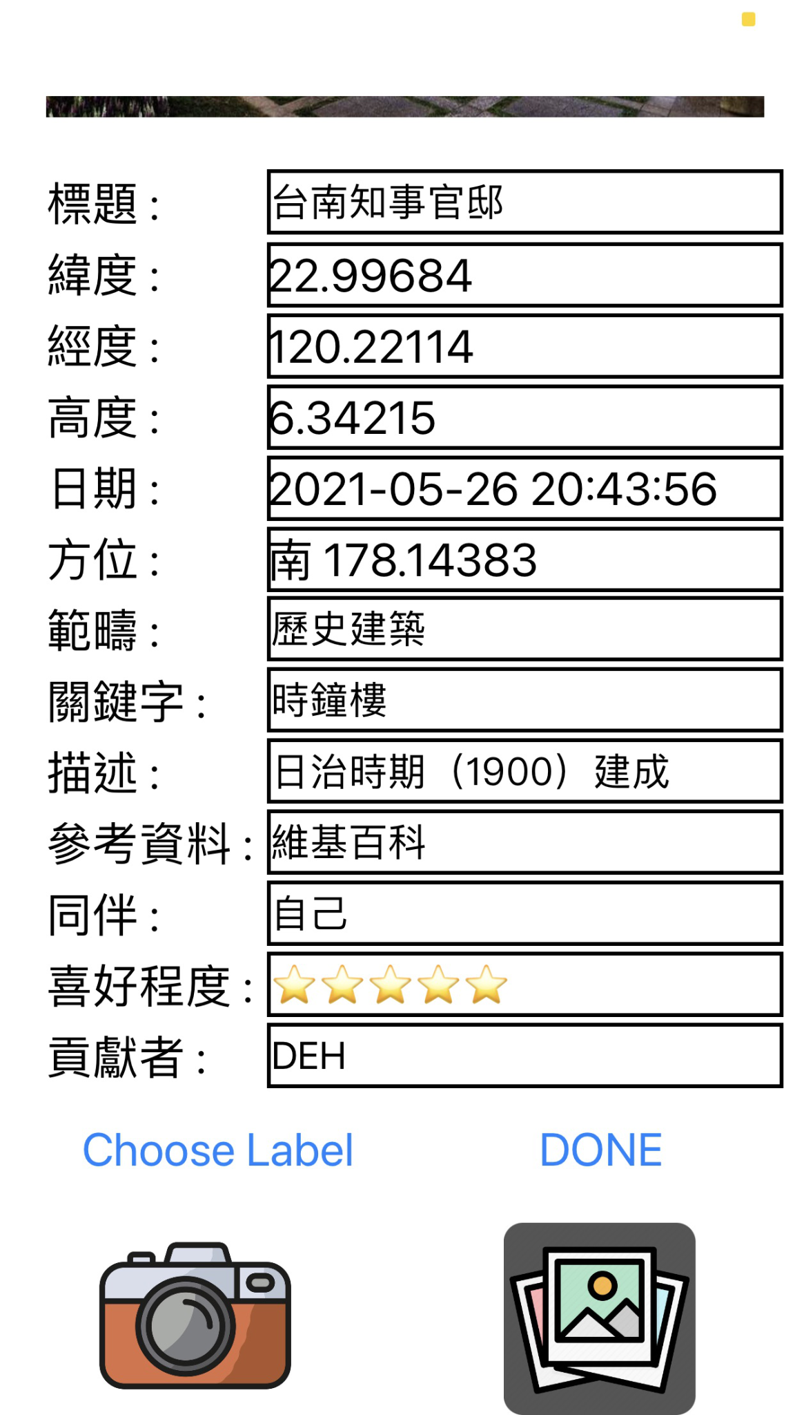
APP - Upload Success
Android
iOS

Slide 28

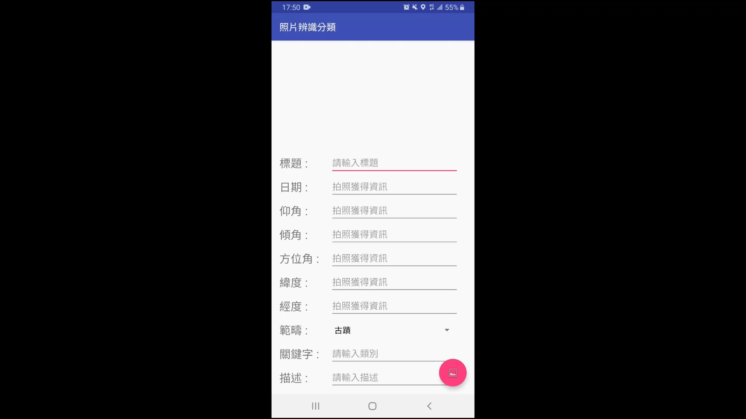
APP DEMO

Slide 29
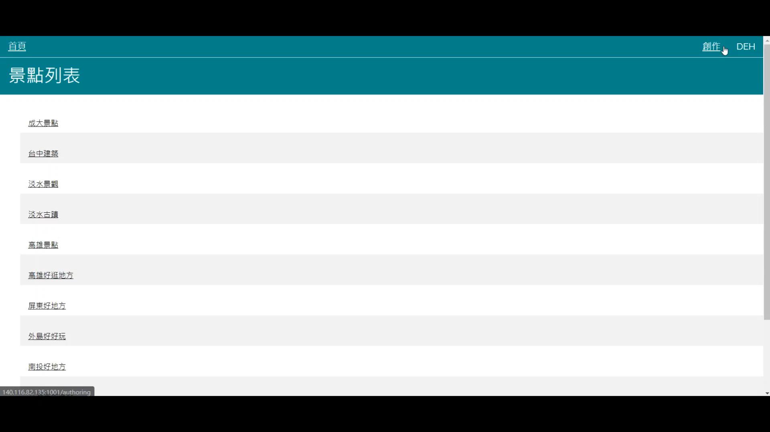
Web Demo

Slide 30

Conclusion

Slide 31


Conclusion
This system offers users a convenient platform to classify and search photos, make POI by these photos and share with others.
This semic-automatic photo classification and searching technology combines human and AI to manually add tags and automatically analyze photos; therefore, helping you save a large amount of time on recording the features of each photo.
Just using a smartphone(Android/iOS) to use this system. Whether making a record of the journey, or collecting and sharing these photos with others, or even creating a POI for handy guided tour, this convenient system must be the only choice for you.

Slide 32

THANKS FOR
YOUR LISTENING

